Slide 1
chicago
Travel plan
Duration: Reading week (3 days) Fall 2023
Budge$1200

Slide 2
DAY One Sat
DAY Two
Sun
DAY Three
Mon
Garfiled Conservatory
China Town
River walk
Cloud Gate
Chicago Art institute
Fountain
Willis Tower
Navy pier
Shakespeare Theatre
Flight preferably 12am arrival on Sat and 6pm departure on Monday

Slide 3
Day 1

Slide 4
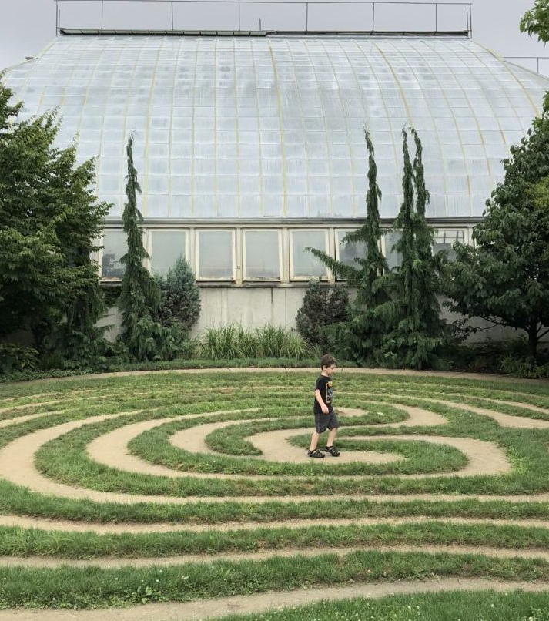
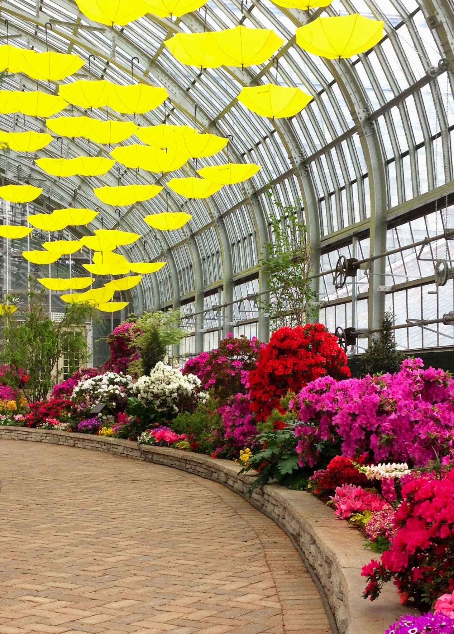
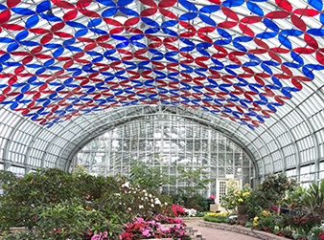
Garfield Garden (need to reserve)
Free admission
Duration 2 hours

Slide 5
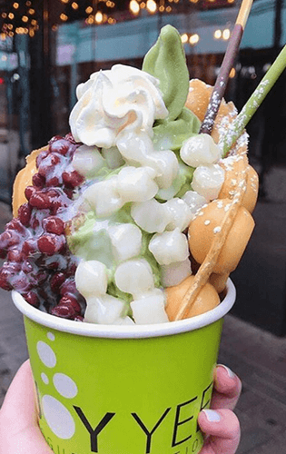
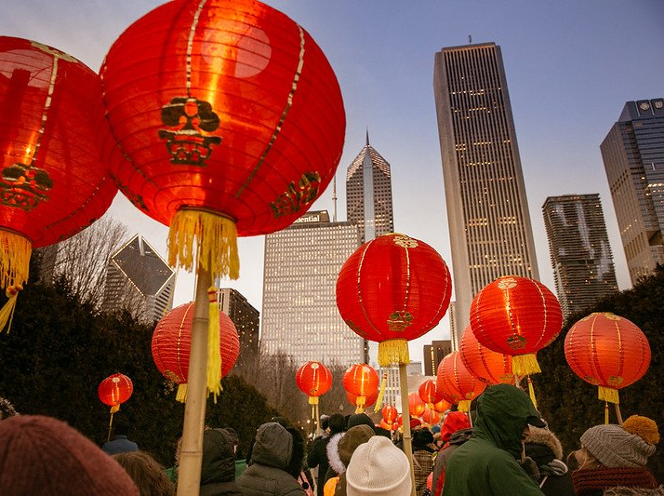
China Town
Try Taiwanese dessert
Look around the markets
Duration: 1 hour

Slide 6
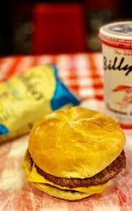
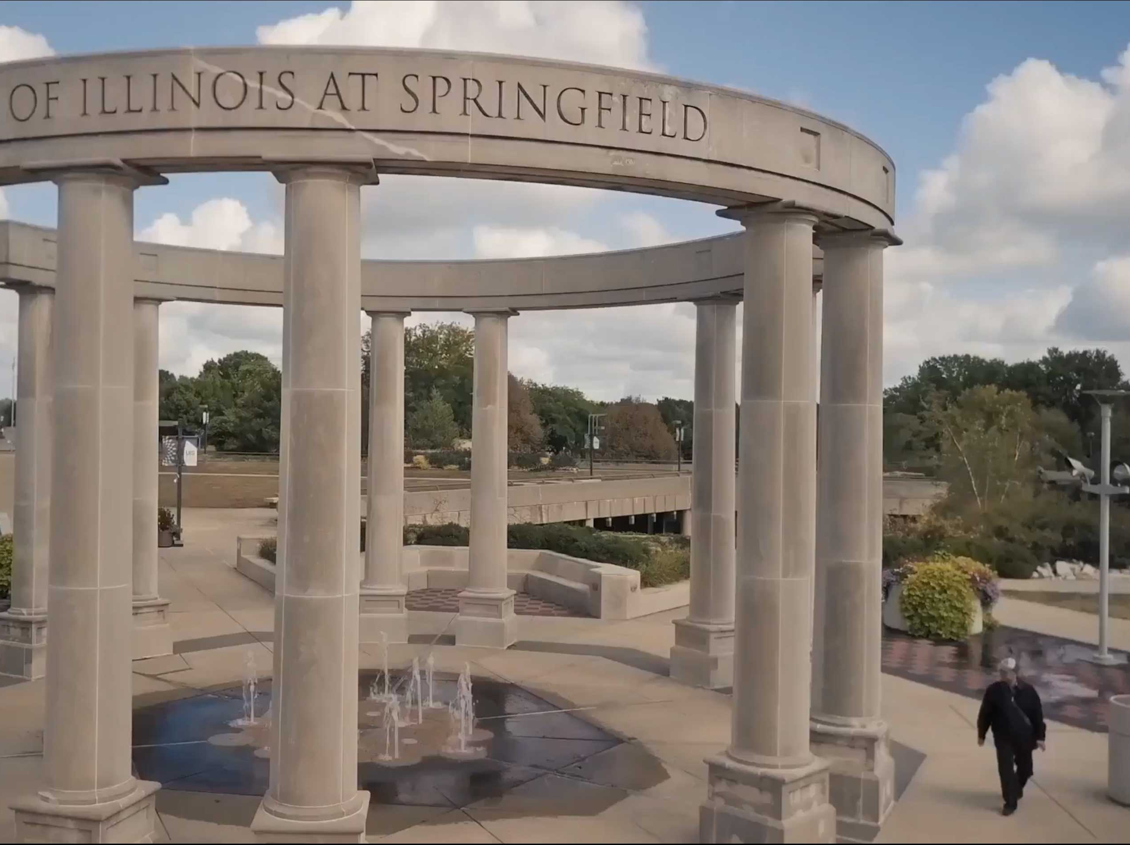
Illinoi university
Visit university
And eat cheese burger at Billy goat tavern

Slide 7
Day 2

Slide 8
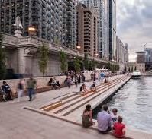
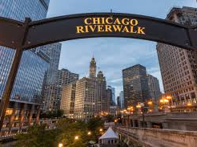
Chicago River Walk
Eat hot dog at Portillios
Eat marios Italian lemonade
Look around river walk
1hour

Slide 9
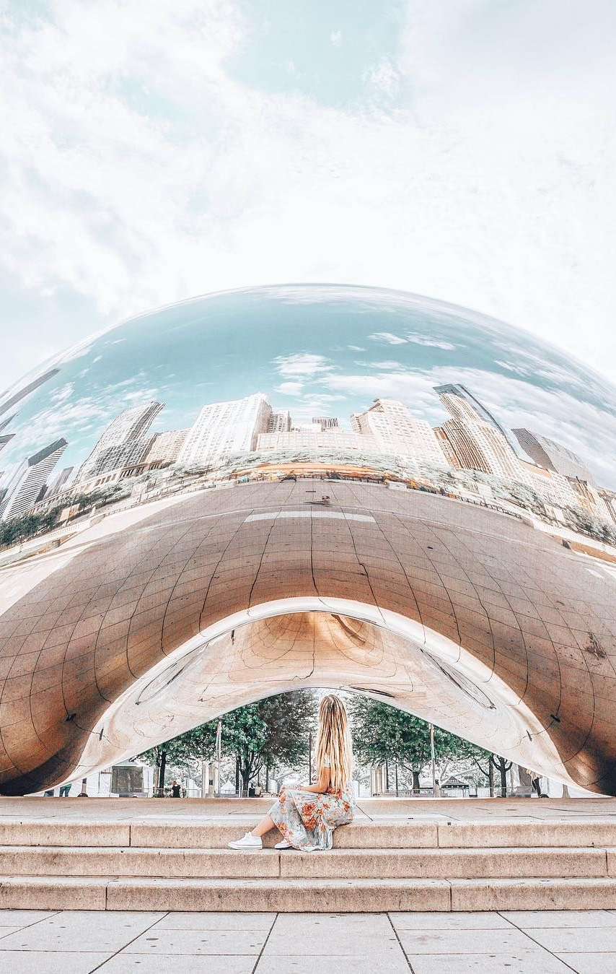
Cloud Gate
Take a picture in font of it
20 min

Slide 10
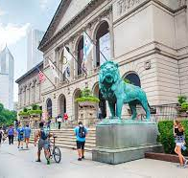
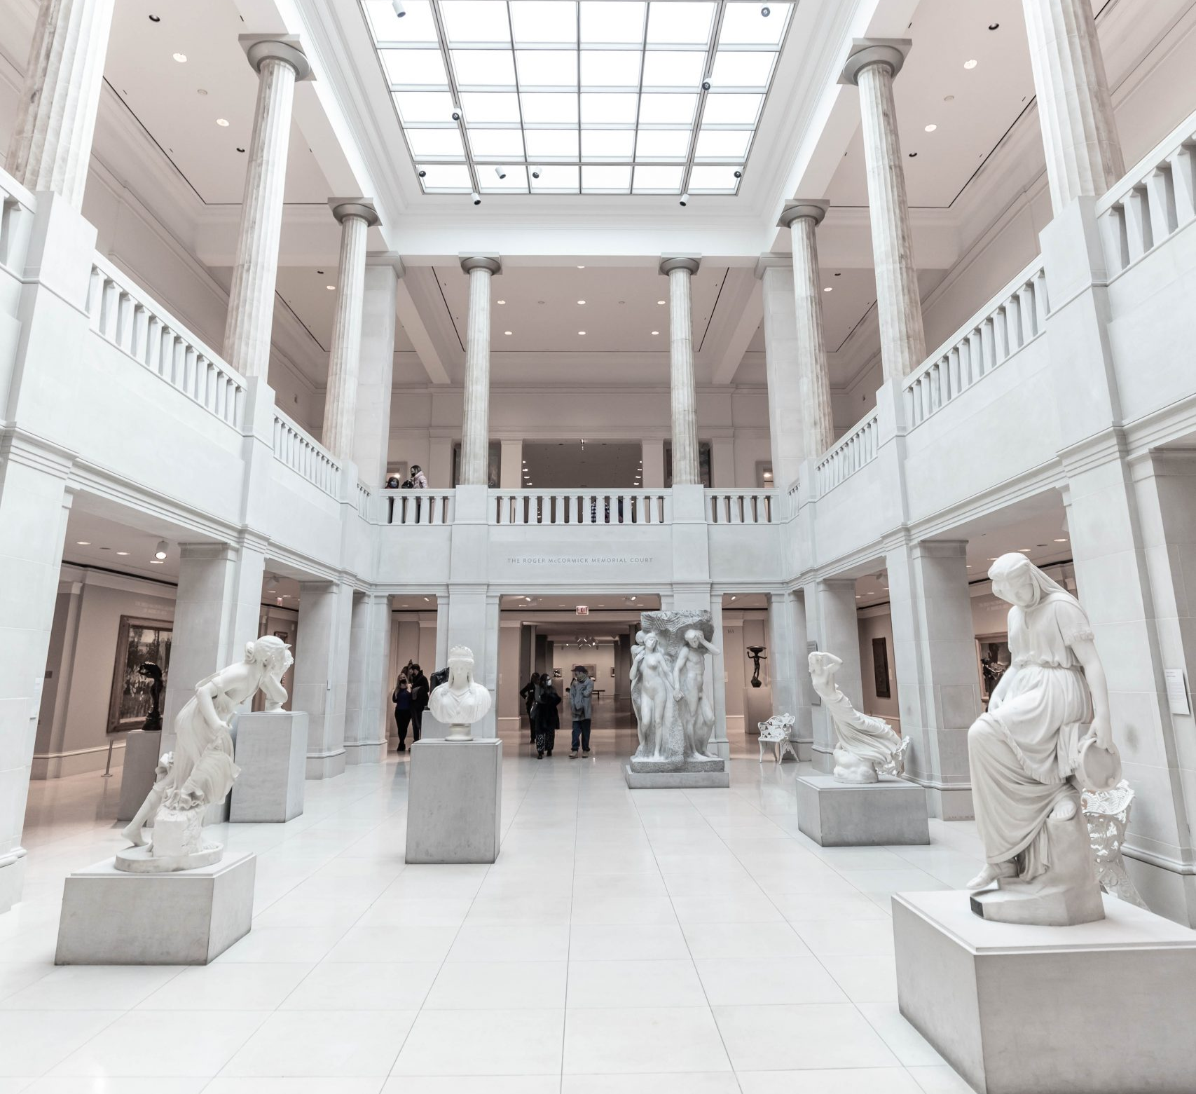
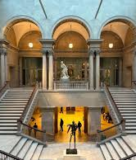
Chicago Art institute
Look around art and take pics
2 hours
Admission ticket*
Eat Garrett Popcorn

Slide 11
Buckingham Fountain
Take a photo here
30min

Slide 12
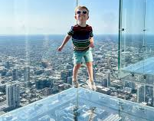
Willis tower
Wllis tower
Buy ticket
1 hour
Eat Shake Shak

Slide 13
DAY 3

Slide 14
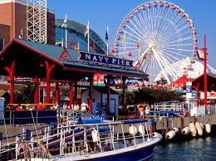
Navy Pier
1 hour looking water
Uno’s deep dish pizza

Slide 15
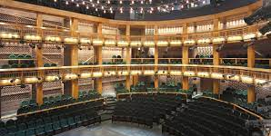
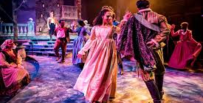
Shakespeare Theatre
Fee: $61
Duration: 2 hours

