Slide 1
Niagara-on-the-lake

Slide 2
Agenda
A
Niagara on the lake heritage district
Neob lavender boutique
Go to Trius Winery
Paddle Queens royal park
Outlet

Slide 3
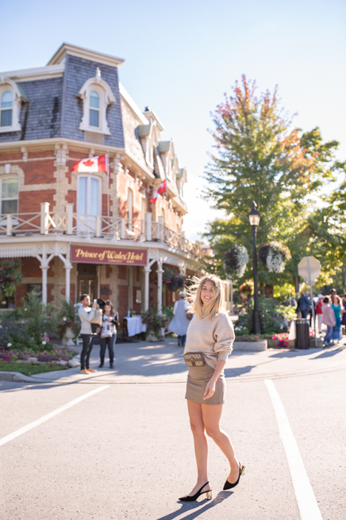
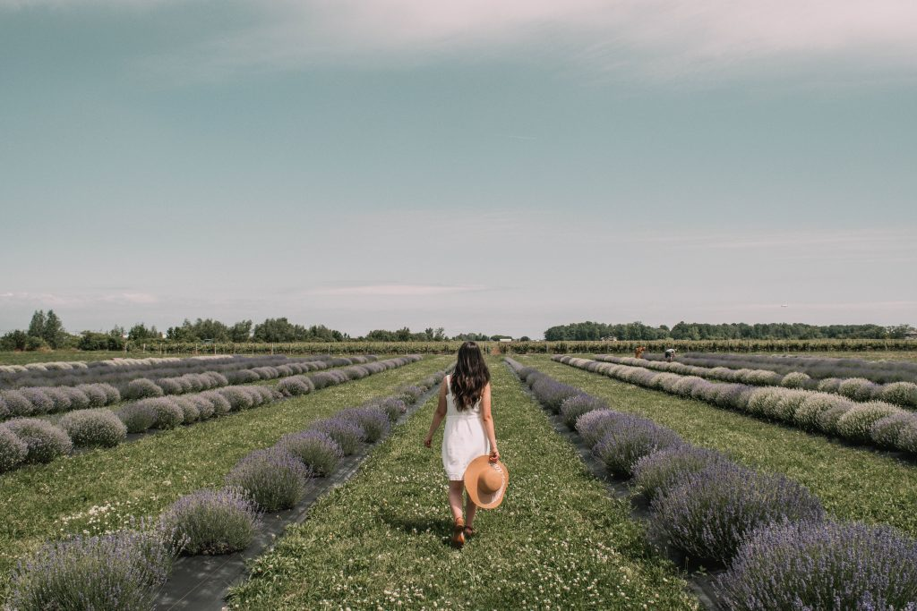
Morning
VIA
Niagara on the lake heritage district
Lavender farm
Take VIA Train to Niagara falls ®
At 8:20-10:20
Take pic in front of tower
Take pic in front of Prince whales of hotel & afternoon tea
11:00-12
Visit lavender farm nearby
Take pics in the farm alley
Eat cows ice cream
12-1

Slide 4
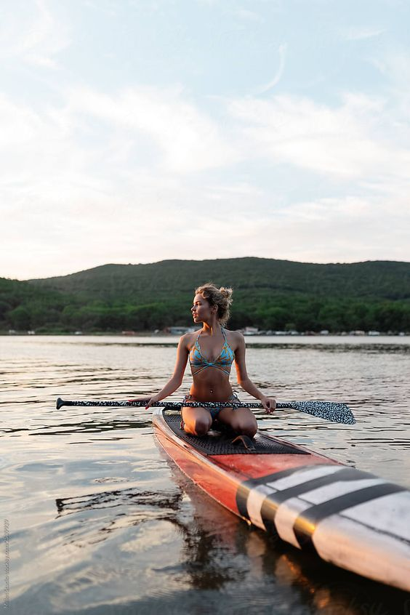
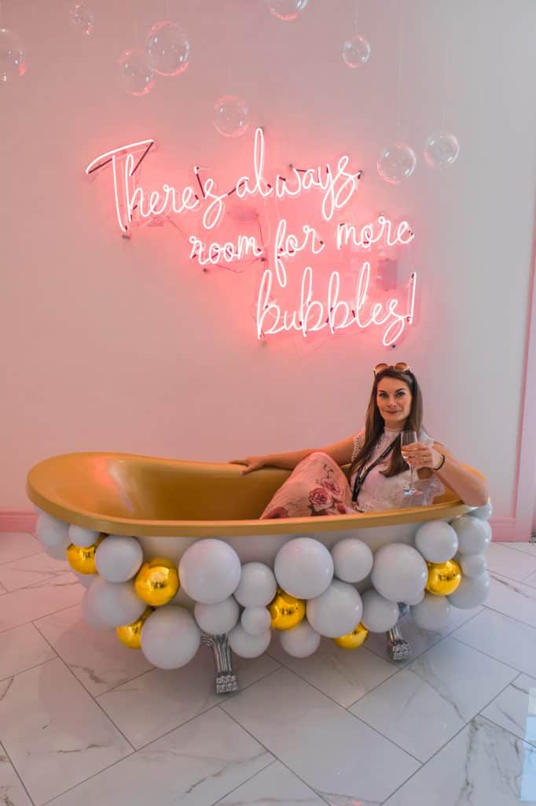
Afternoon
Paddle Niagara
Trius Winery
Outlet
Get the paddle boat ®
Take pics in water
Go to gazebo
1-2
Online ticket ® take uber here
Take pics
Have dinner here
3-4
Take pic in patio
Look around
Uber
Go back to via by 5:30
Take bus 12
4-5

